Slide 1


Bugs and Bug Tracking
Defects, Reports, Lifecycle and Bug Tracking Systems
SoftUni Team
Technical Trainers
Software University
https://about.softuni.bg

Slide 2
Table of Contents
Software Bugs
Bug Report
Bug Lifecycle
Tips for Bug Reporting
Bug Tracking Systems
Incident Management Metrics

Slide 3
You Have Questions?
sli.do #QA-Basics

Slide 4

Software Bugs
Problems in the Code → Cause Failure / Misfunction

Slide 5

Software Defects Recap
A software bug is an error in a computer program or system that causes it to behave unexpectedly or not perform as intended.
Humans can make errors (mistakes)
Errors produce defects
Defects are bugs in the program code, or mistakes in the requirements / design / other
If a defect is executed, it might cause a failure / misfunction:
Fail to do what it should do / do wrong thing

Slide 6
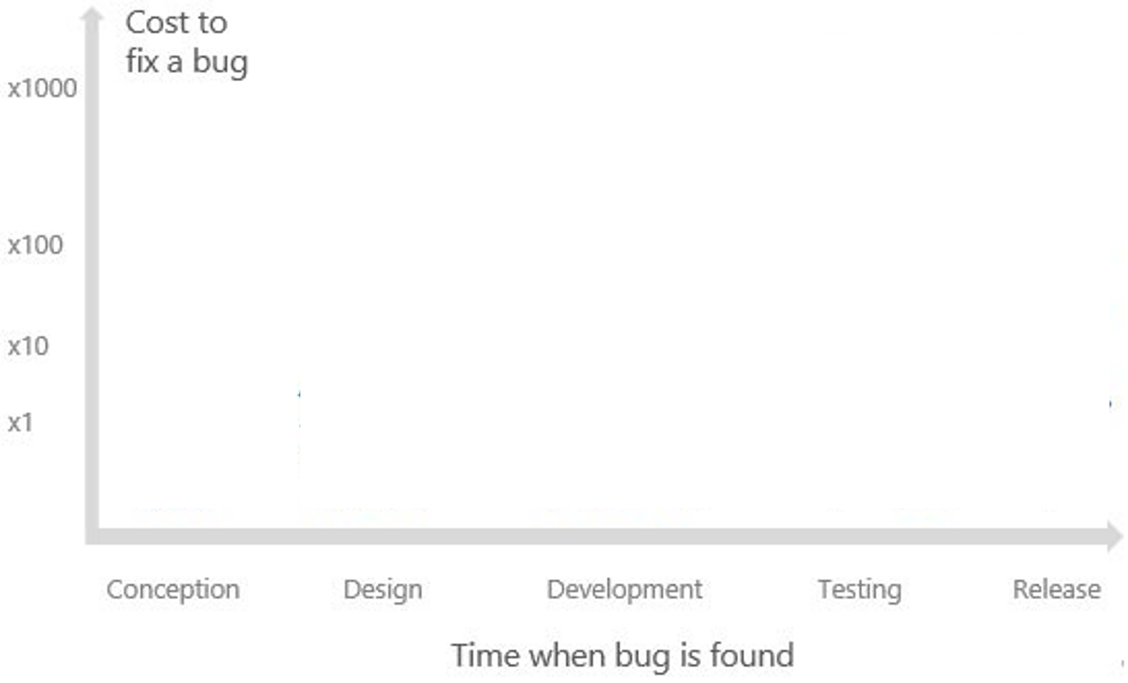

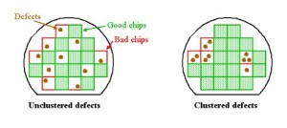
Bug Fixing Importance
As the "Seven Testing Principles" state:
"Early testing saves time and money"
The faster you fix the bug the less damage it causes
"Defects cluster together"
Unfixed bugs hide other bugs

Slide 7

Bug Report
Bug Description in a Detailed, Reproducible Format

Slide 8
Bug Report
What is a "bug report"?
Written document describing a certain bug found during a concrete phase in the testing process
Why we need it?
Provides detailed information about the problem
Helps in keeping the records for future reference
Categorizes the bugs to help in root cause analysis
Avoids reporting a duplicate

Slide 9
Bug Report Example
Bug ID: SB-21
Priority:
Severity:
Assigned to: Peter White
Reported By: Maria Nelson
Reported On: 06.01.2023
Status: New
Environment: https://test.website.com/chatter
Summary: Group chat creators cannot rename it
Description: Any participant of a group conversation should be able to rename it. The bug is produced only for the creator of a group conversation. All other participants are able rename the group conversation.
Expected behavior: All participants should be able to rename a group conversation.
Actual behavior: the [Rename Conversation] button is disabled for the creator of the group conversation.
Steps to reproduce:
Open https://test.website.com
Sign in: login – test3 / password – testtest
Open a chat dialog, titled "Test Chat"
Open [Settings] => [Add User]
Add any user to a group conversation => click [Done]
Click again on the settings to rename the group conversation
Next release
Low

Slide 10

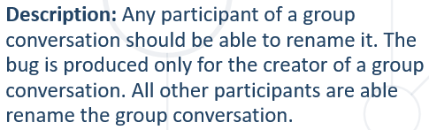

What Goes in a Bug Report? (1)
Summary
Short statement / title of the problem
Description
Describe the problem, including
Anomalies
Inputs + expected + actual output
Environment
URLs
Screenshots
Notes:
Book: Foundations of Software Testing ISTQB Certification - 5.6 INCIDENT MANAGEMENT

Slide 11
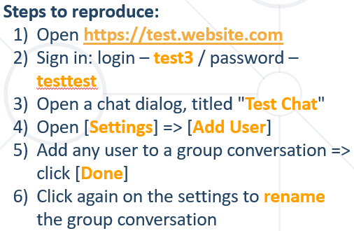

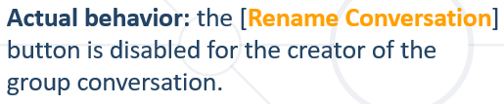
What Goes in a Bug Report? (2)
Steps to reproduce
Expected behavior
What was supposed to happen?
Actual behavior
What actually happened?
1. ……… 2. ………
3. ………
Procedure steps
Notes:
Book: Foundations of Software Testing ISTQB Certification - 5.6 INCIDENT MANAGEMENT

Slide 12
What Goes in a Bug Report? (3)
References to external sources
Specification documents
Various work items
Attachments
Videos and screenshots
Any additional information about the configuration
Notes:
Book: Foundations of Software Testing ISTQB Certification - 5.6 INCIDENT MANAGEMENT

Slide 13

What Goes in a Bug Report? (4)
Severity and priority of the bug
Classified by testers or by a bug triage committee
The bug triage determines also the risks, costs, opportunities and benefits of fixing or not fixing the bug
Priority | immediate, next release, on occasion, open
Severity | blocking, critical, high, medium, low
Notes:
Book: Foundations of Software Testing ISTQB Certification - 5.6 INCIDENT MANAGEMENT

Slide 14

Bug Severity
What is a bug "severity“ ?
Degree of impact that a bug has on the operation of the product
Associated with functionality or standards
Indicates the seriousness of the defect
Driven by functionality
Severity value is objective and less likely to change
Based on the technical aspect of the product
Notes:
Book: Foundations of Software Testing ISTQB Certification - 5.6 INCIDENT MANAGEMENT

Slide 15
Bug Severity Levels (1)
Stops the user from using the feature as it is meant to be used
No reasonable workaround
Blocking
Data corruption
Easily and repeatedly throws an exception
No reasonable workaround
Feature does not work as expected
Critical
Notes:
Book: Foundations of Software Testing ISTQB Certification - 5.6 INCIDENT MANAGEMENT

Slide 16
Bug Severity Levels (2)
Throws an exception when not following the happy path
Confusing UI
Has a reasonable workaround
High
Feature works off the happy path with minor issues
Small UI issues
One or more reasonable workarounds
Medium
Cosmetic issues
Many workarounds
Low visibility to users
Low
Notes:
Book: Foundations of Software Testing ISTQB Certification - 5.6 INCIDENT MANAGEMENT

Slide 17

Bug Priority
What is a bug "priority"?
Indicates how soon the bug should be fixed
Defines the order in which a bug should be fixed
Associated with scheduling
Decided in consultation with the manager / client
Driven by business value
Based on customer's requirements
Priority value is subjective and can change over a period of time, depending on changes in the project's situation
Notes:
Book: Foundations of Software Testing ISTQB Certification - 5.6 INCIDENT MANAGEMENT

Slide 18
Priority Classification
Sample priority classification could be:
1 – Immediate / High – must be resolved as soon as possible
2 – Next Release / Medium – should be resolved in the normal course of development activities. It can wait until a new build or version is created
3 – On Occasion / Low – can be deferred until after more serious bug has been fixed
4 – Open – not planned for now

Slide 19
Priority and Severity Examples (1)
High Priority and High Severity
Key feature fails and there's no workaround
Submit button is not working on a login page and customers are unable to login to the application
High Priority and Low Severity
Basic feature error, but it has huge impact on customer's business
Spelling mistake on the title page or wrong company logo

Slide 20
Priority and Severity Examples (2)
Low Priority and High Severity
A functional error of the application and there is no workaround, but is rarely used by the end user
Calculation fault in yearly report, which end user won't use on daily basis
Low Priority and Low Severity
Cosmetic or spelling issues which is within a paragraph
Font family mismatch in a comment section

Slide 21

Bug Lifecycle
The Life of a Bug

Slide 22
Bug Lifecycle
Bug reports are managed through a lifecycle
Its purpose is to make the bug fixing process systematic
New
Duplicate
/ Rejected
/ Deferred
/ Not A Bug
Open
Assigned
Fixed
Verified
Re-open
Closed

Slide 23
Bug Lifecycle States (1)
New
Open
Assigned
Notes:
Book: Foundations of Software Testing ISTQB Certification - 5.6 INCIDENT MANAGEMENT

Slide 24
Bug Lifecycle States (2)
Fixed
Rejected
Duplicate
Notes:
Book: Foundations of Software Testing ISTQB Certification - 5.6 INCIDENT MANAGEMENT

Slide 25
Bug Lifecycle States (3)
Verified
Reopened
Closed
Notes:
Book: Foundations of Software Testing ISTQB Certification - 5.6 INCIDENT MANAGEMENT

Slide 26


Tips for Bug Reporting
Best Practices

Slide 27


Key Points for Good Bug Report (1)
Clear and succinct title / summary
Reproducibility
Bad: Browser crashed
Good: Error 404: Page not found when clicking the [Export] button
Bad: Leave it blank
Good: "Every time", "Occasionally", "Unable to Reproduce"
Notes:
Results from the course?

Slide 28


Key Points for Good Bug Report (2)
Description
Supporting information
Bad: It crashes
Good: The [Export] button crashes with "500 Internal Server Error" for non-admin users
Bad: Leave it blank
Good: "This error happens for all event records that are fees, but works for event records that are campaigns"
Notes:
Results from the course?

Slide 29
Key Points for Good Bug Report (3)
Actual results
Expected results
Bad: It did not work
Good: Error 403: Forbidden
Bad: I expected it to work
Good: "I expected to see a popup after clicking the Run button"
Notes:
Results from the course?

Slide 30


Key Points for Good Bug Report (4)
Platform
Include screenshots or attachments if possible
Bad: Windows
Good: Windows 10, Google Chrome 103.0.5060.134
Notes:
Results from the course?

Slide 31

Bug Tracking Systems
How to Track Bugs the Easy Way

Slide 32

Bug Tracking Systems
What is a bug tracking system?
Bug tacking system examples:
Jira
GitHub Issues
BugZilla
ClickUp
A bug tracking system is a software application that keeps track of reported software bugs in software development projects. It may be regarded as a type of issue tracking system.

Slide 33

Live Demo
Register a Bug with Jira
Notes:
33

Slide 34
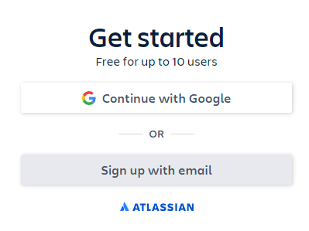

How to Register a Bug (Using Jira) (1)
Go to Jira's official website
Press on the [Get it free] button in the top bar
Press on the [Next] button
You will be brought to the "Sign up" screen

Slide 35
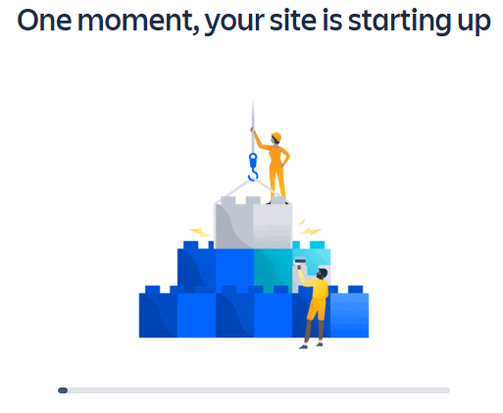
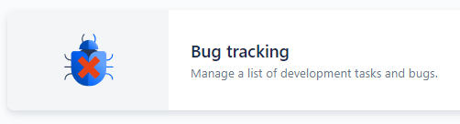
How to Register a Bug (Using Jira) (2)
Choose your site name
Then, choose the bug tracking template
Now you have your projects page

Slide 36
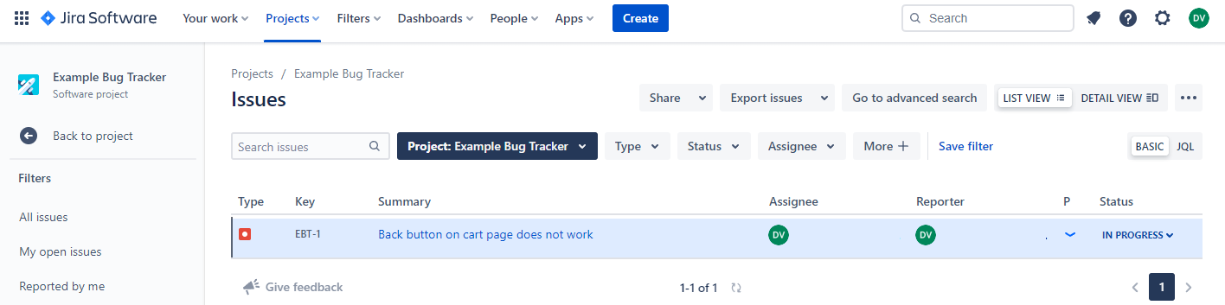
How to Register a Bug (Using Jira) (3)
Button to create a brand-new issue
Your projects list of bugs – including who was assigned to it, who reported it, etc.
Your projects dashboard

Slide 37
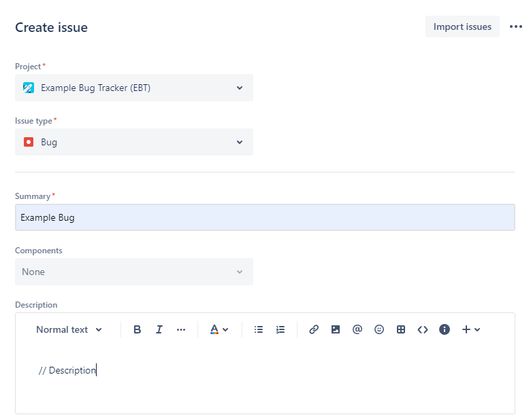
How to Register a Bug (Using Jira) (4)
From here you can fill out your bug report
Project you are reporting on
What kind of issues you are reporting (bug, feature, improvement etc.)
Fill out the required fields (summary, description, steps to reproduce, etc.)

Slide 38
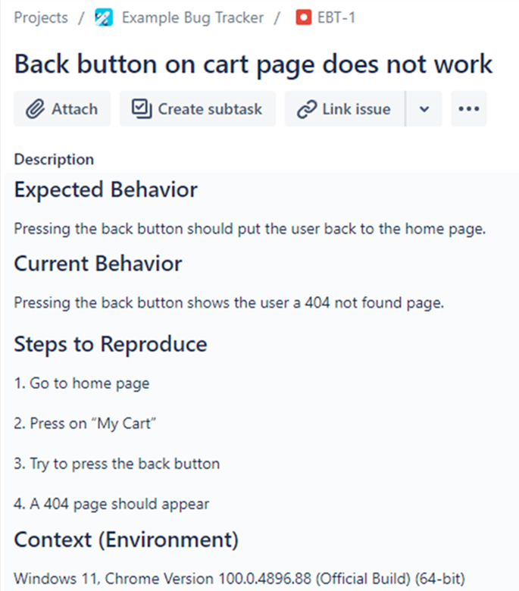
How to Register a Bug (Using Jira) (5)
After that you will see your brand-new bugs page
Notice how a bug was logged using only what was discussed earlier

Slide 39
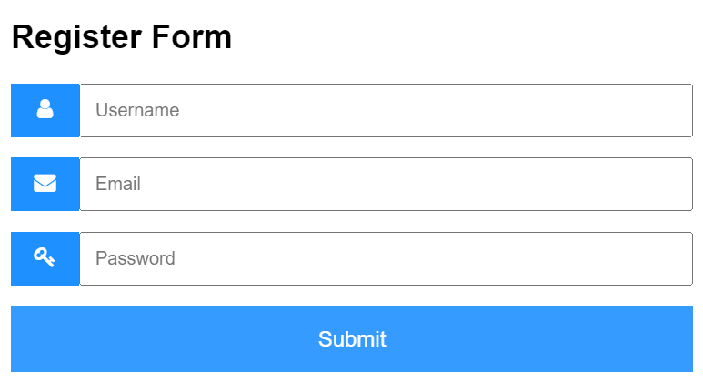
Demo: Bug Reporting on a Register Form
Find and log the "Disappearing Submit Button" bug
http://softuni-qa-amazonaws.com/disappearing-button/

Slide 40

Incident Management Metrics
Determine Whether Specific Goals are Met

Slide 41
Incident Management Metrics
Total number of defects
Number of open (active) bugs/tasks
Number of bugs found before release
Bugs resolved ratio (resolved errors)
Bug rejection ratio (rejected errors)
Bug leakage ratio (undetected errors)
Bugs per category

Slide 42
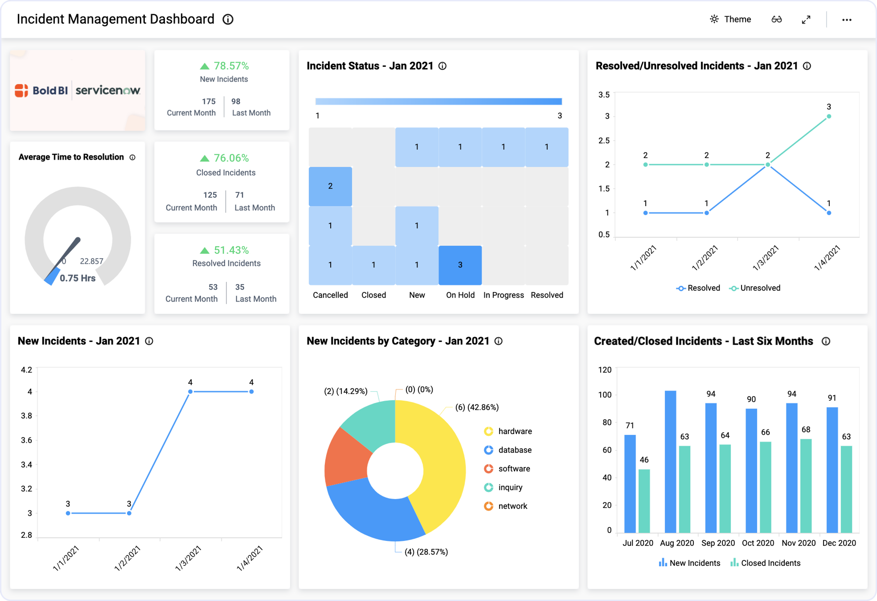
Example Dashboard

Slide 43
Summary
…
…
…
Errors in a software program can cause it to unexpectedly quit or behave in an unintended manner
What goes in a bug report?
Bug reports are managed through a lifecycle that is used to make the bug fixing process systematic
Writing good bug reports
Bug tracking systems and how to use one
Incident management metrics

Slide 44
Questions?
Notes:
44

Slide 45














SoftUni Diamond Partners

Slide 46

Educational Partners

Slide 47

License
This course (slides, examples, demos, exercises, homework, documents, videos and other assets) is copyrighted content
Unauthorized copy, reproduction or use is illegal
© SoftUni – https://about.softuni.bg/
© Software University – https://softuni.bg
Notes:
47

Slide 48
Trainings @ Software University (SoftUni)
Software University – High-Quality Education, Profession and Job for Software Developers
softuni.bg, about.softuni.bg
Software University Foundation
softuni.foundation
Software University @ Facebook
facebook.com/SoftwareUniversity
Software University Forums
forum.softuni.bg
Notes:
48

